Slide 1
Extended QoS
Daniel Mager
25.10.2022

Slide 2
Agenda
Goals
Basic architecture overview
Demonstration
Further steps

Slide 3
Goals
Different views on how to measure quality of a service (QoS)
Usually basic IT metrics (latency, bandwidth, etc.)
Business metrics (costs, result accuracy, etc.)
Combine both into terms QoS or SQ (service quality)
Different use-cases within a local cloud
Need for different QoS definitions (/calculation strategies)
Multiple definitions need to be available
User (Service Consumer) chooses strategy for orchestration

Slide 4
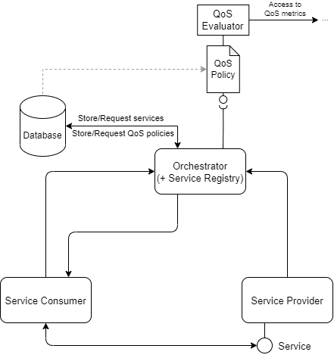
Basic architecture overview
Evaluator
Implementation of specific QoS strategy
Retrieve metrics, calculate QoS and modify list of possible services (sort, filter, etc.)
Optional parameters
Available Evaluators (JARs) loaded at orchestrator startup (like plugins)
Policy
Description of QoS strategy
Sets Evaluator to use
Parameters for Evaluator can be set (e.g. commonly used values)
Default policies can be set (globally or consumer-specific)

Slide 5
Demonstration
Prometheus Metrics Exporter
Offers to register a QoS metric (label + value)
Configured to be scraped by Prometheus
Test Provider
2 Providers (identified by Port 8591 and 8592)
Provide simple „get-result“ service
Simple UI for setting QoS metrics „ping“ and „job execution time“
Test Consumer
Consumes „get-result“ service
Simple UI to set QoS strategy, optional parameters and start service request
TotalTimeSortingPolicy: Sorts services by ping and jobExecutionTime (lower is better)
Consumes first service in orchestration result

Slide 6
Further steps
Further develop proof-of-concept implementation
Get current progress from forked repo into a new branch of main repository
Implement reputation system to verify providers comply with their advertised QoS
Create QoS strategies and Evaluators for real use-cases

Slide 7
Any more questions?

